Slide 1
NEXT HIKES IT SOLUTIONS
PRICE MODEL
MEMORY
128 GB
Feature Extraction
& Mobile Price Prediction
RAM
8 GB
EST. PRICE
Predicting smartphone prices from product specifications
₹34,999
BY • SANDEEP SINGH

Slide 2
MOBILE PRICE PREDICTION / MACHINE LEARNING
Project at a glance
A regression workflow to estimate mobile prices from device specifications.
DATASET
MODELS
UNSEEN TEST
FINAL R²
541 cleaned records
11 core columns
Target: price
Random Forest
Decision Tree
433 train
108 test
0 common models
0.709
Random Forest
MAIN TAKEAWAY
Random Forest generalised better when evaluated on mobile models absent from training.

Slide 3
MOBILE PRICE PREDICTION / MACHINE LEARNING
Problem statement
Why estimate mobile prices from specifications?
THE CHALLENGE
THE ML APPROACH
Prices vary with memory, RAM, camera, battery, processor, brand and model.
The relationship between specifications and price can be complex.
Learn patterns from historical device records and estimate a numeric price from product features.
Regression is suitable because price is a continuous target.
The project evaluates both familiar-record prediction and generalisation to unseen phone models.

Slide 4
DATA UNDERSTANDING / STEP 01
Libraries & initial dataset inspection
The notebook begins by loading the data tools and checking the dataset structure.
Pandas
Data loading and tabular manipulation
NumPy
Numerical operations
Matplotlib & Seaborn
Charts and visual exploration
Scikit-learn
Preprocessing, splitting and regression models
INITIAL CHECKS
head() • shape • info() • missing values • duplicates • descriptive statistics

Slide 5
DATA UNDERSTANDING / STEP 02
A look at the dataset
The first inspection checks how device specifications and target price are represented.
MODEL
COLOUR
MEMORY
RAM
BATTERY
REAR CAM
FRONT CAM
PRICE
Phone model
Colour
128
8
5000
50MP
16MP
₹34,999
Phone model
Black
64
4
5000
13MP
8MP
₹12,999
Phone model
Blue
256
8
4500
48MP
12MP
₹49,999
Illustrative layout only — the actual notebook dataset contains 541 records and 11 original features. The target column is price.

Slide 6
MOBILE PRICE PREDICTION / MACHINE LEARNING
Data cleaning & preprocessing
Improve consistency before analysis and modelling.
01
Standardised column names and renamed prize to price.
02
Removed the unnamed index-like column.
03
Converted camera and price fields to numeric values.
04
Changed two suspicious mobile_height values (41.94) to missing.
05
Filled missing mobile_height values using the median.
06
Final data: 541 rows × 11 columns; no missing values remained.

Slide 7
DATA PREPARATION / STEP 03
Data cleaning: numerical & categorical fields
Cleaning focused on consistent types, usable values and reliable model inputs.
NUMERICAL COLUMNS
CATEGORICAL COLUMNS
• Memory
• RAM
• Battery
• AI Lens
• Mobile Height
• Price
• Rear Camera (MP)
• Front Camera (MP)
• Model
• Colour
• Processor
Camera strings and price text were converted to numeric values; suspicious mobile-height entries were handled before modelling.

Slide 8
MOBILE PRICE PREDICTION / MACHINE LEARNING
Feature engineering
Derived variables designed to represent device characteristics.
total_camera
ram_storage_ratio
rear_camera + front_camera
RAM / memory
brand
processor_brand
First token extracted from model name
First token extracted from processor text
Note: brand and processor_brand use a simple first-token rule and may contain imperfect labels.

Slide 9
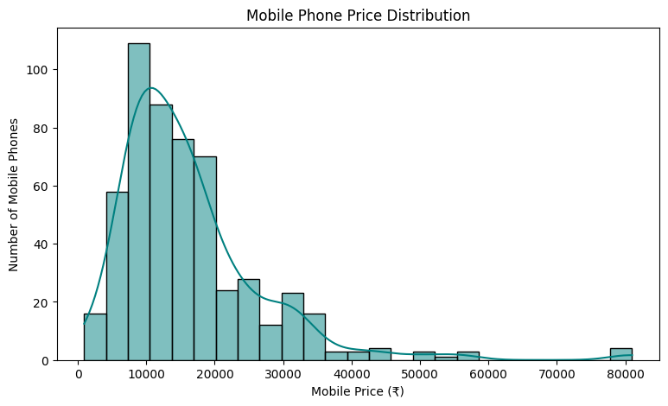
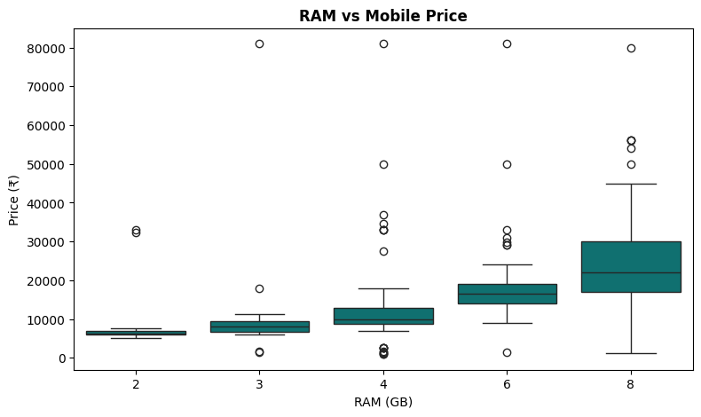
EXPLORATORY DATA ANALYSIS / STEP 04
Distribution analysis of key features
The EDA stage inspected the spread of price and major hardware specifications.

Slide 10
MOBILE PRICE PREDICTION / MACHINE LEARNING
Modelling workflow
Encoding and training process for unseen-model validation.
01
02
03
04
05
Predictors
& target
›
Group-based
split
›
One-hot
encoding
›
Train
regressors
›
Evaluate
metrics
Unseen-model validation: 433 training records • 108 testing records • 0 common models

Slide 11
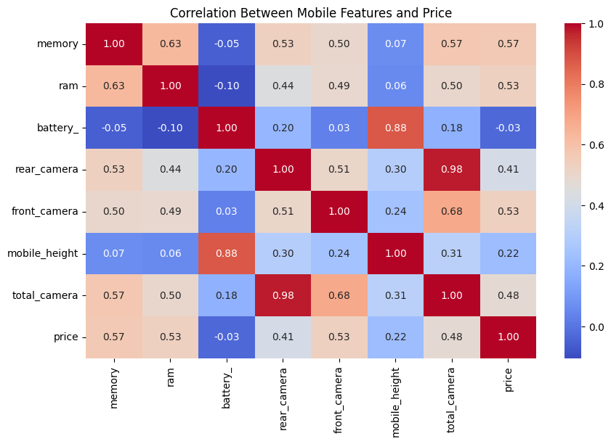
MOBILE PRICE PREDICTION / MACHINE LEARNING
Numerical correlation with price
Recorded correlations from the exploratory analysis.

Slide 12
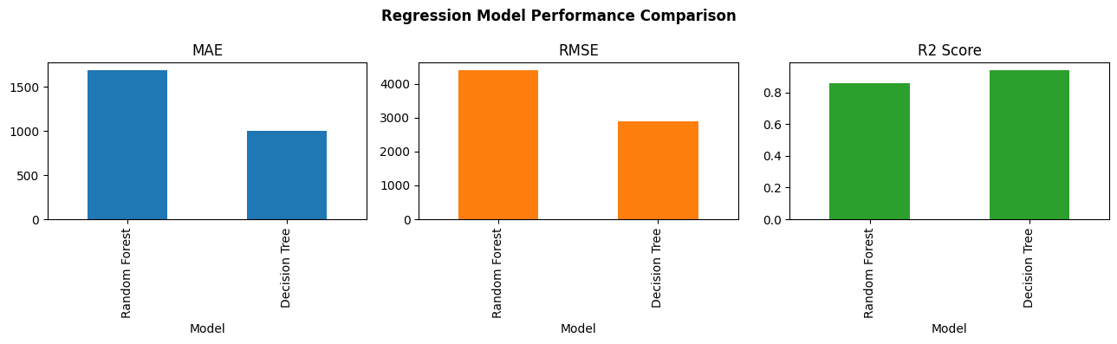
MOBILE PRICE PREDICTION / MACHINE LEARNING
Regression models
Two tree-based approaches were compared.

Slide 13
MOBILE PRICE PREDICTION / MACHINE LEARNING
Corrected record-level results
Random record split: familiar models may appear in both sets.
METRIC
RANDOM FOREST
DECISION TREE
MAE (₹)
1,686.74
1,346.52
RMSE (₹)
4,423.35
4,433.55
R²
0.858
0.857
On this record-level split, the models were very close: Decision Tree had lower MAE, while Random Forest had slightly lower RMSE and marginally higher R².

Slide 14
MOBILE PRICE PREDICTION / MACHINE LEARNING
Five-fold cross-validation
Mean R² was equal, but fold-to-fold variation differed.
RANDOM FOREST
DECISION TREE
Scores: 0.825 • 0.874 • 0.830 • 0.814 • 0.925
Mean R²: 0.854
Scores: 0.905 • 0.863 • 0.915 • 0.826 • 0.759
Mean R²: 0.854
Both models had the same average cross-validation R². Random Forest's scores varied less in this run.

Slide 15
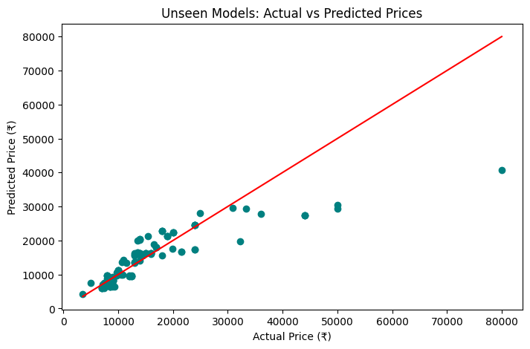
MOBILE PRICE PREDICTION / MACHINE LEARNING
Unseen mobile model validation
Group-based split: no model identity shared across train and test.

Slide 16
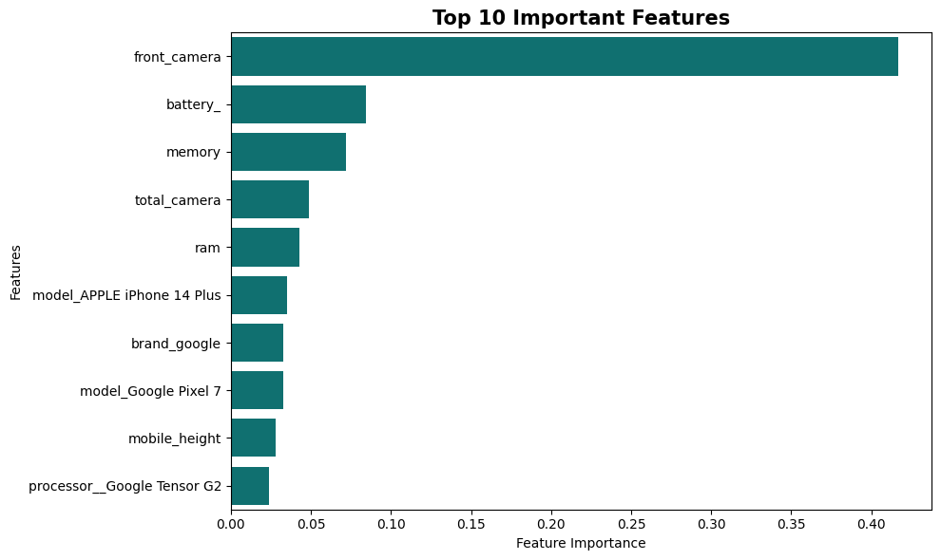
MOBILE PRICE PREDICTION / MACHINE LEARNING
Key insights & limitations
What the analysis revealed.

Slide 17
MOBILE PRICE PREDICTION / CONCLUSION
Conclusion & future scope
SELECTED MODEL • RANDOM FOREST
FUTURE IMPROVEMENTS
Unseen-model MAE: ₹3,235.63
Unseen-model RMSE: ₹5,914.05
Unseen-model R²: 0.709
Add premium-phone examples
Tune hyperparameters
Improve brand/processor parsing
Validate on external data
THANK YOU
Questions & discussion • Sandeep Singh

